Slide 1





Unravelling HPCIA prescription trends in veterinary healthcare
An LLM approach towards antimicrobial stewardship surveillance in the UK
Sean Farrell

Slide 2
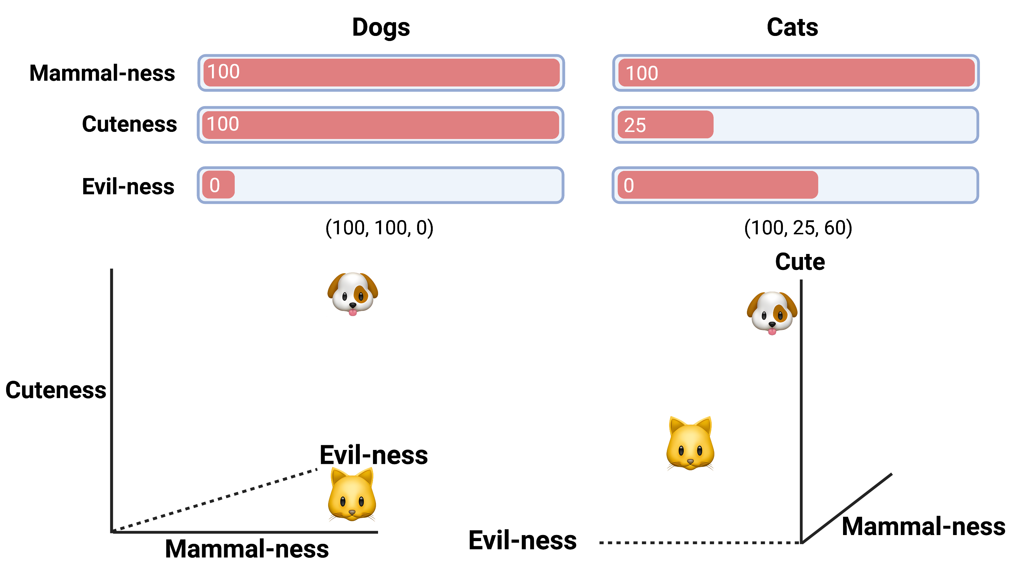

Slide 8
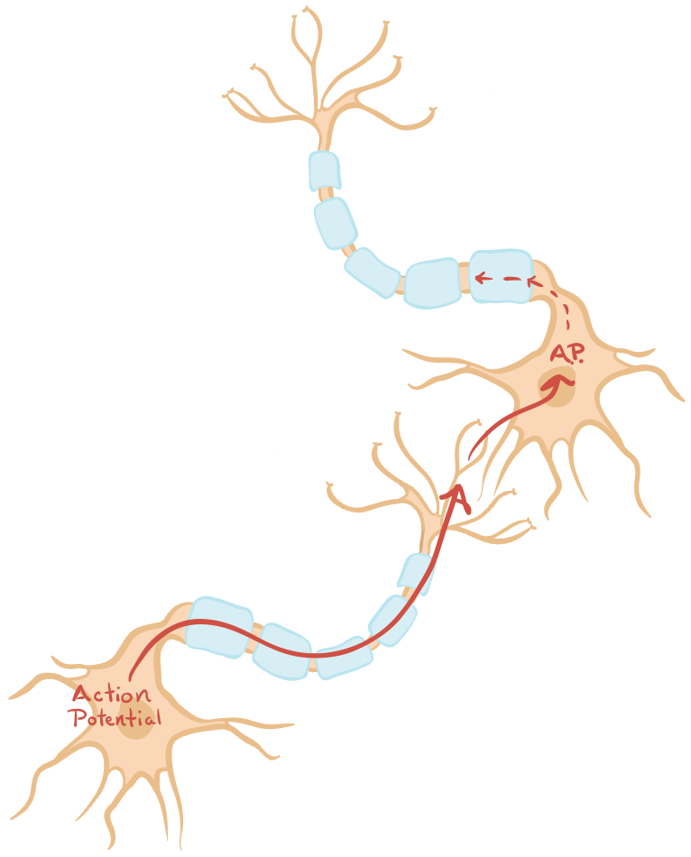
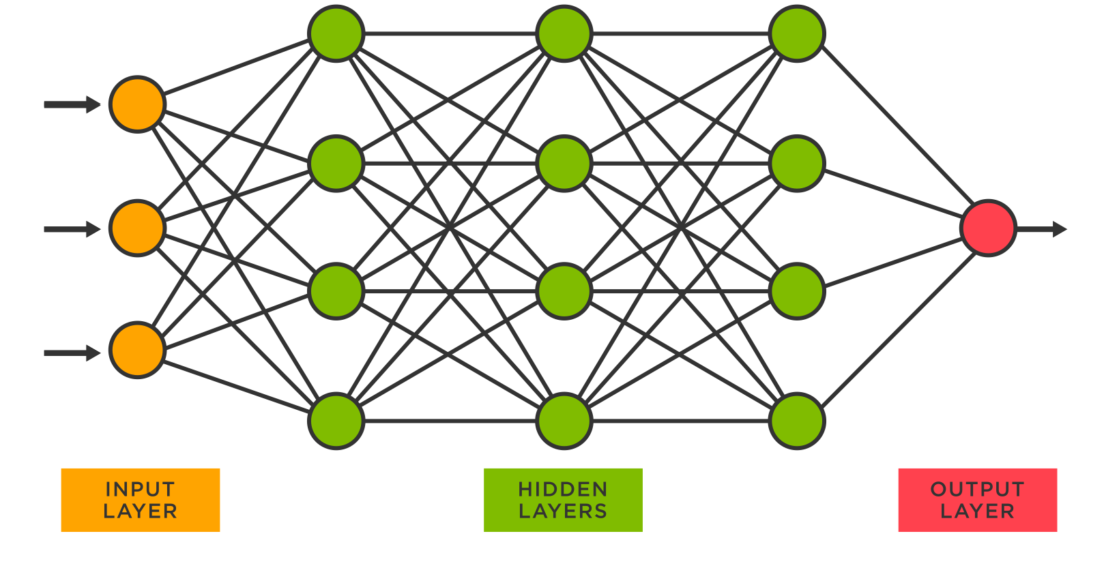
Neural Networks

Slide 9
Task: Next Word Prediction
Mitochondria is the …

Slide 10
Task: Next Word Prediction
Mitochondria is the Powerhouse of the cell

Slide 11
Task: Next Word Prediction
Mitochondria is the Powerhouse of the cell
Organelle that generates energy in cells

Slide 12
3. Neural Networks: Backwards Pass
0.2863), (1.2307), (2.5174), (0.9929), (-3.7714), (-1.2208), (0.0851), (-0.2373), (-2.4234), (1.7426), (-0.1505), (-0.8594), (4.8210), (-0.8130), (2.5217), (0.6487), (0.4648), (-1.4481), (-0.9089), (0.0548), (2.3526), (-0.3699), (1.1465), (0.5105), (2.3646), (-0.7747), (4.9055), (-1.3934), (-1.8953), (-1.3712), (2.4309), (5.2719), (2.0144), (1.8627), (1.4278), (-2.4139), (-1.0946), (-0.3024), (-4.2780), (-0.3049), (0.6957), (0.4319), (1.8508), (-1.8022), (-0.3920), (-2.1429), (0.2166), (2.2102), (3.7859), (1.0934), (-0.3237), (-0.8731), (-2.2672), (0.1332), (1.9536), (2.7384), (1.3187), (4.8000), (-3.3562), (-1.1232), (-0.7049), (0.4410), (-2.6155), (0.0512), (1.9210), (2.6836), (-0.4785), (-4.0392), (-1.9838), (-1.3981), (0.3803), (-0.4307), (-1.9314), (0.7149), (0.7923), (-5.1067), (2.1485), (0.1936), (0.5231), (5.1777), (-1.1731), (2.1841), (2.2894), (-1.0185), (-0.5580), (-2.9298), (-2.5891), (-1.2704),
(-0.8370), (-0.9963), (1.0568), (1.4176), (0.5535), (1.9373), (1.5074), (4.8390), (-2.9668), (-1.0379), (-0.3057), (-4.2351), (1.4341), (-1.4620), (-0.3731), (1.8755), (-1.4893), (-2.8241), (3.3332), (-0.0906), (1.8898), (0.8625), (-1.7802), (0.5090), (4.2222), (-2.3364), (1.1773), (1.8600), (-0.3164), (0.2378), (-2.1901), (0.7255), (0.9425), (-1.8687), (-0.2551), (0.1737), (-1.6383), (1.0909), (0.9690), (-0.1866), (-0.4658), (-0.6676), (0.7904), (-1.1645), (-0.7734), (-3.5555), (-1.1131), (-1.0456), (0.4416), (1.2329), (1.4033), (1.1766), (-2.2999), (-0.4118), (-0.1187), (-0.1156), (0.3535), (-0.1656), (-0.3172), (0.1175), (-4.8242), (2.8076), (1.2973), (-1.1101), (0.8656), (-0.4163), (2.3488), (-4.3332), (0.2469), (-0.6439), (-1.4424), (0.1270), (1.7528), (-2.7184), (1.4846), (0.4549), (-2.4588), (2.0927), (0.1093), (1.3892), (-3.8110), (0.7903), (1.0432), (2.6847), (0.5939), (-0.1726), (-0.5155), (0.3859),
Powerhouse
Organelle
-

Slide 13
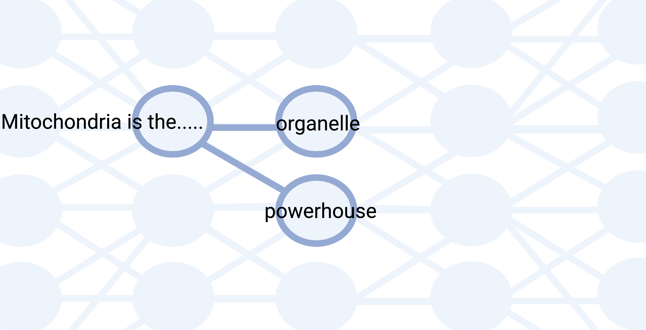
3. Neural Networks: Forward Pass

Slide 14
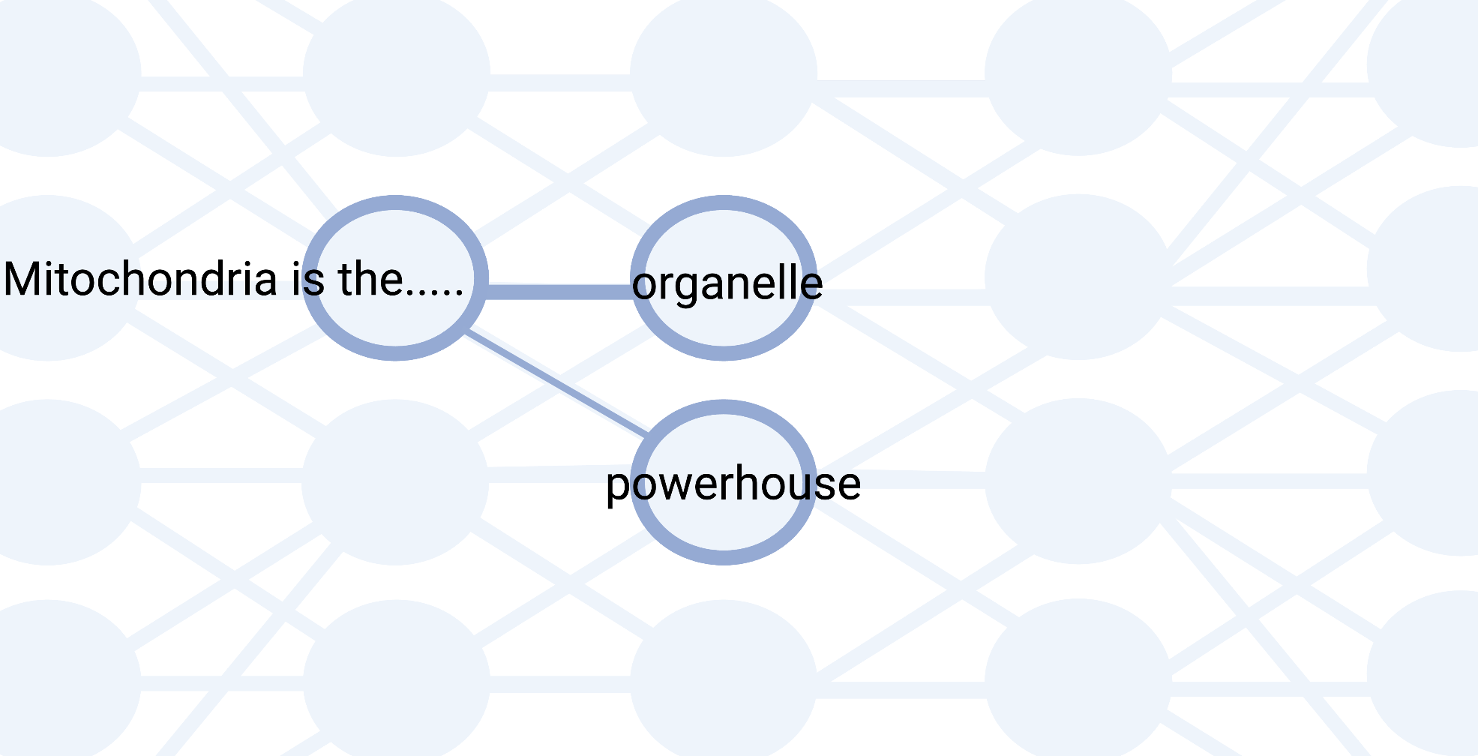
3. Neural Networks: Forward Pass

Slide 15
Unravelling HPCIA prescription trends in veterinary healthcare
An LLM approach towards antimicrobial stewardship surveillance in the UK
Sean Farrell

Slide 16
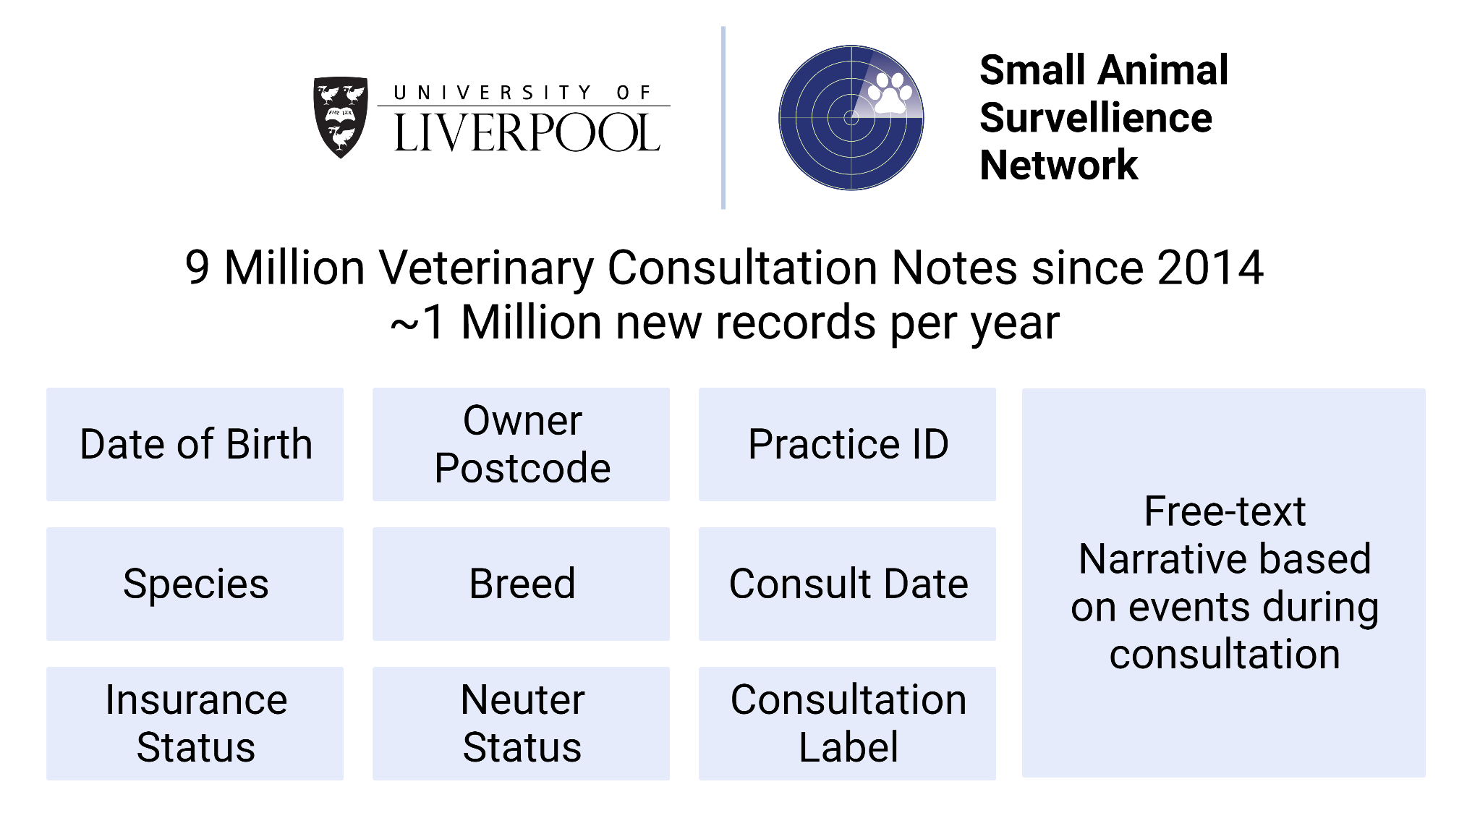
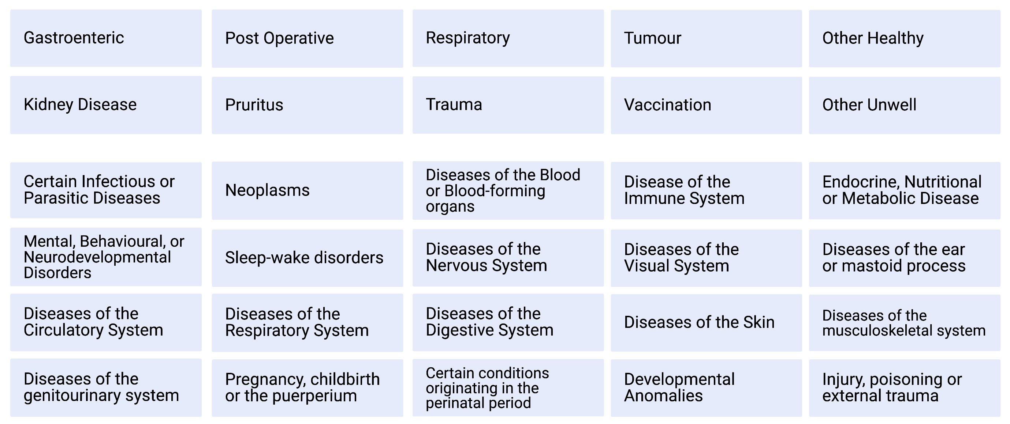
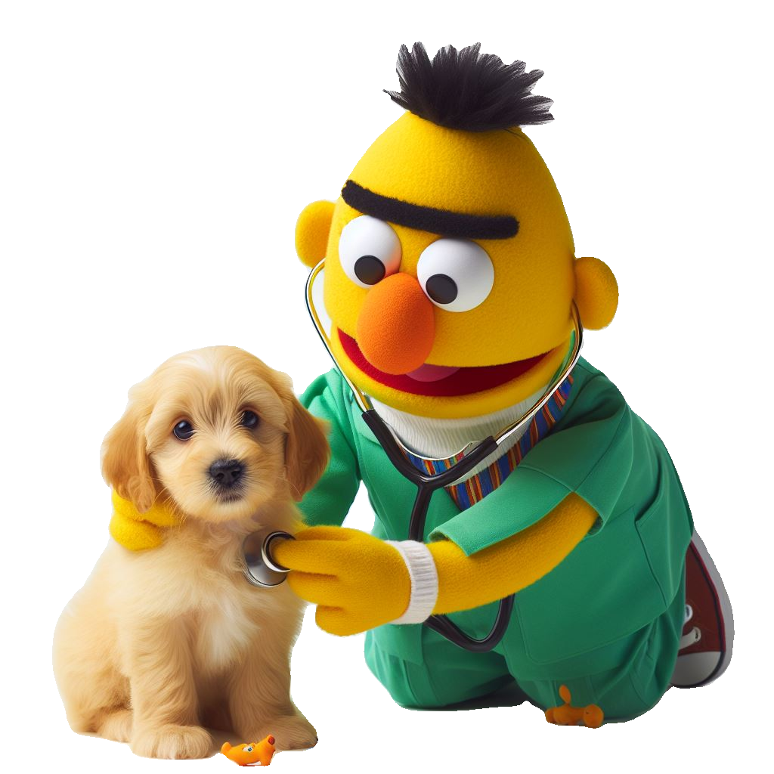
PetBERT
+
=
Fine-tuned
SAVSNET Corpus
N = 5.1 Million
500 Million Words
BERT
PetBERT

Slide 17
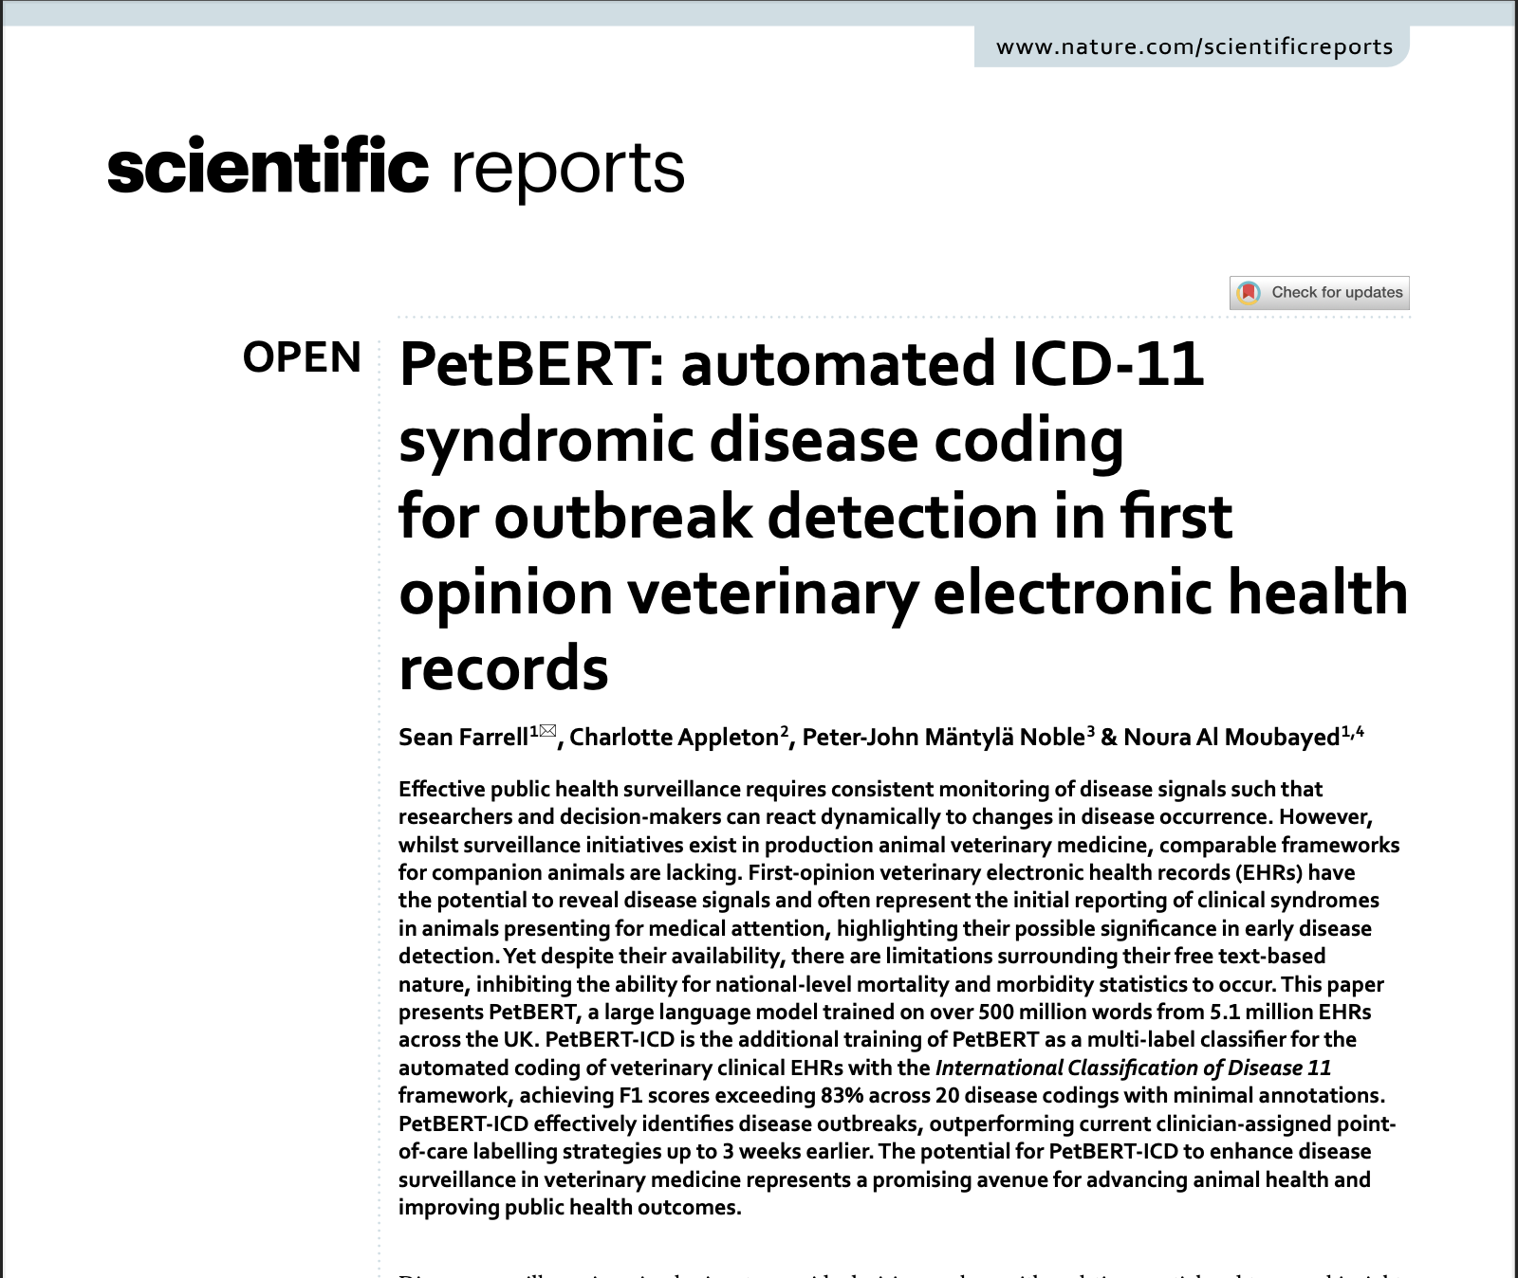
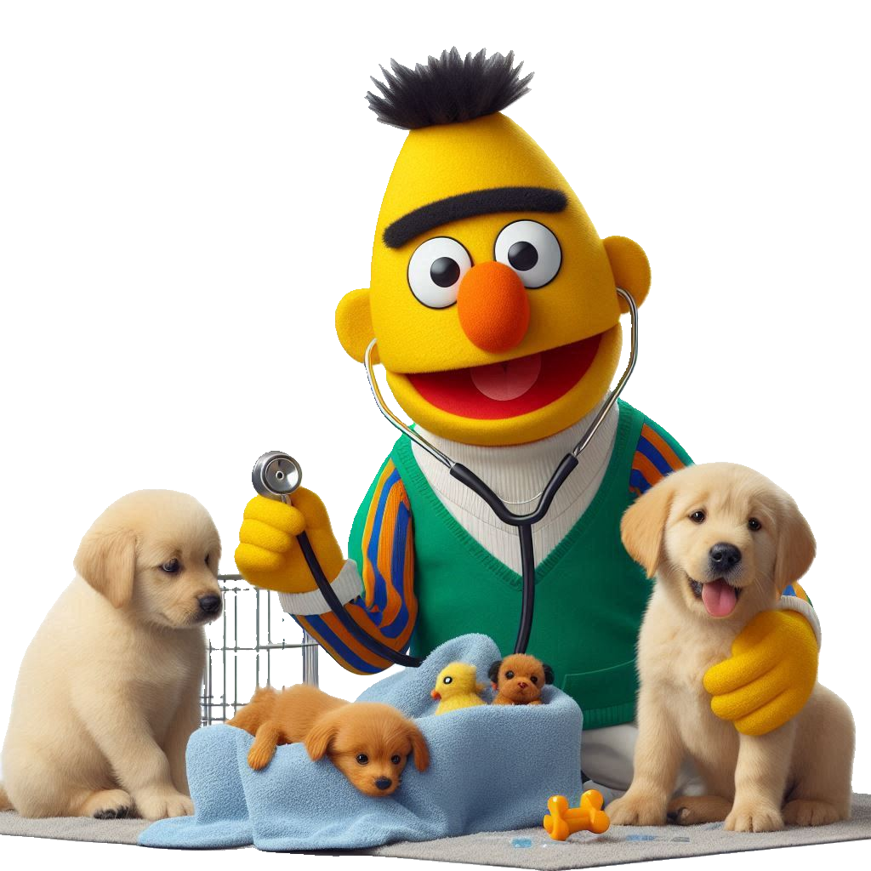
Syndromic Prescribing Patterns
International Classification of Disease 11 (ICD-11)

Slide 18
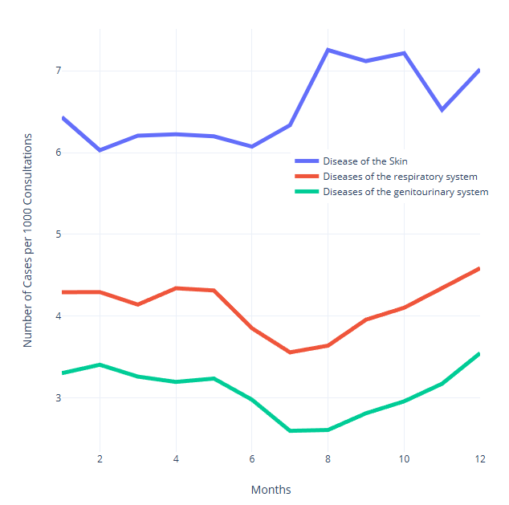
Syndromic Prescribing Patterns
HPCIA Prescriptions per
1000 consultations
International Classification of Disease 11 (ICD-11)

Slide 19
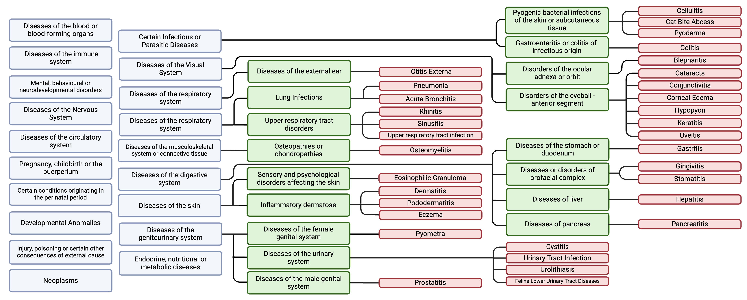

Disease Level Prescribing Patterns

Slide 20
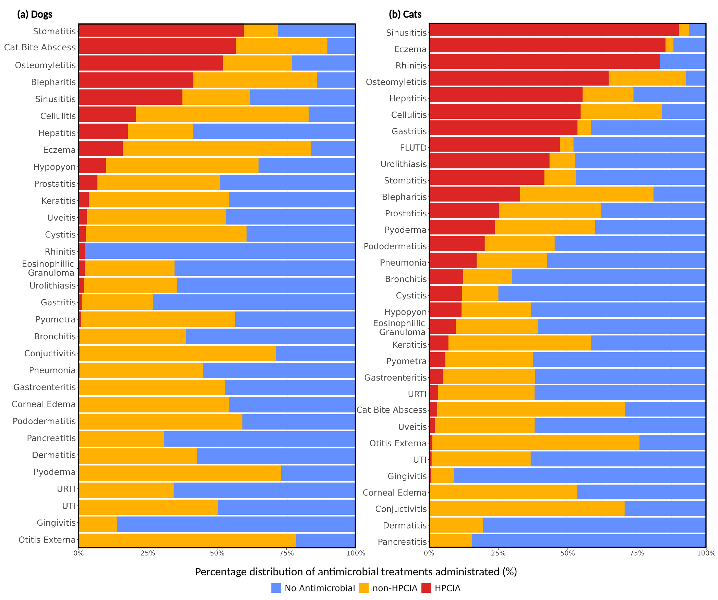
Disease Level Prescribing
Patterns: HPCIA vs Non-HPCIA vs No Antimicrobial
“Less than 20% of all antimicrobials in cats are topical”
“Cefovecin being the most used HPCIA across 30 of the studied diseases”
“Systemic antimicrobials account for 56% of total antimicrobial treatments in dog”

Slide 21
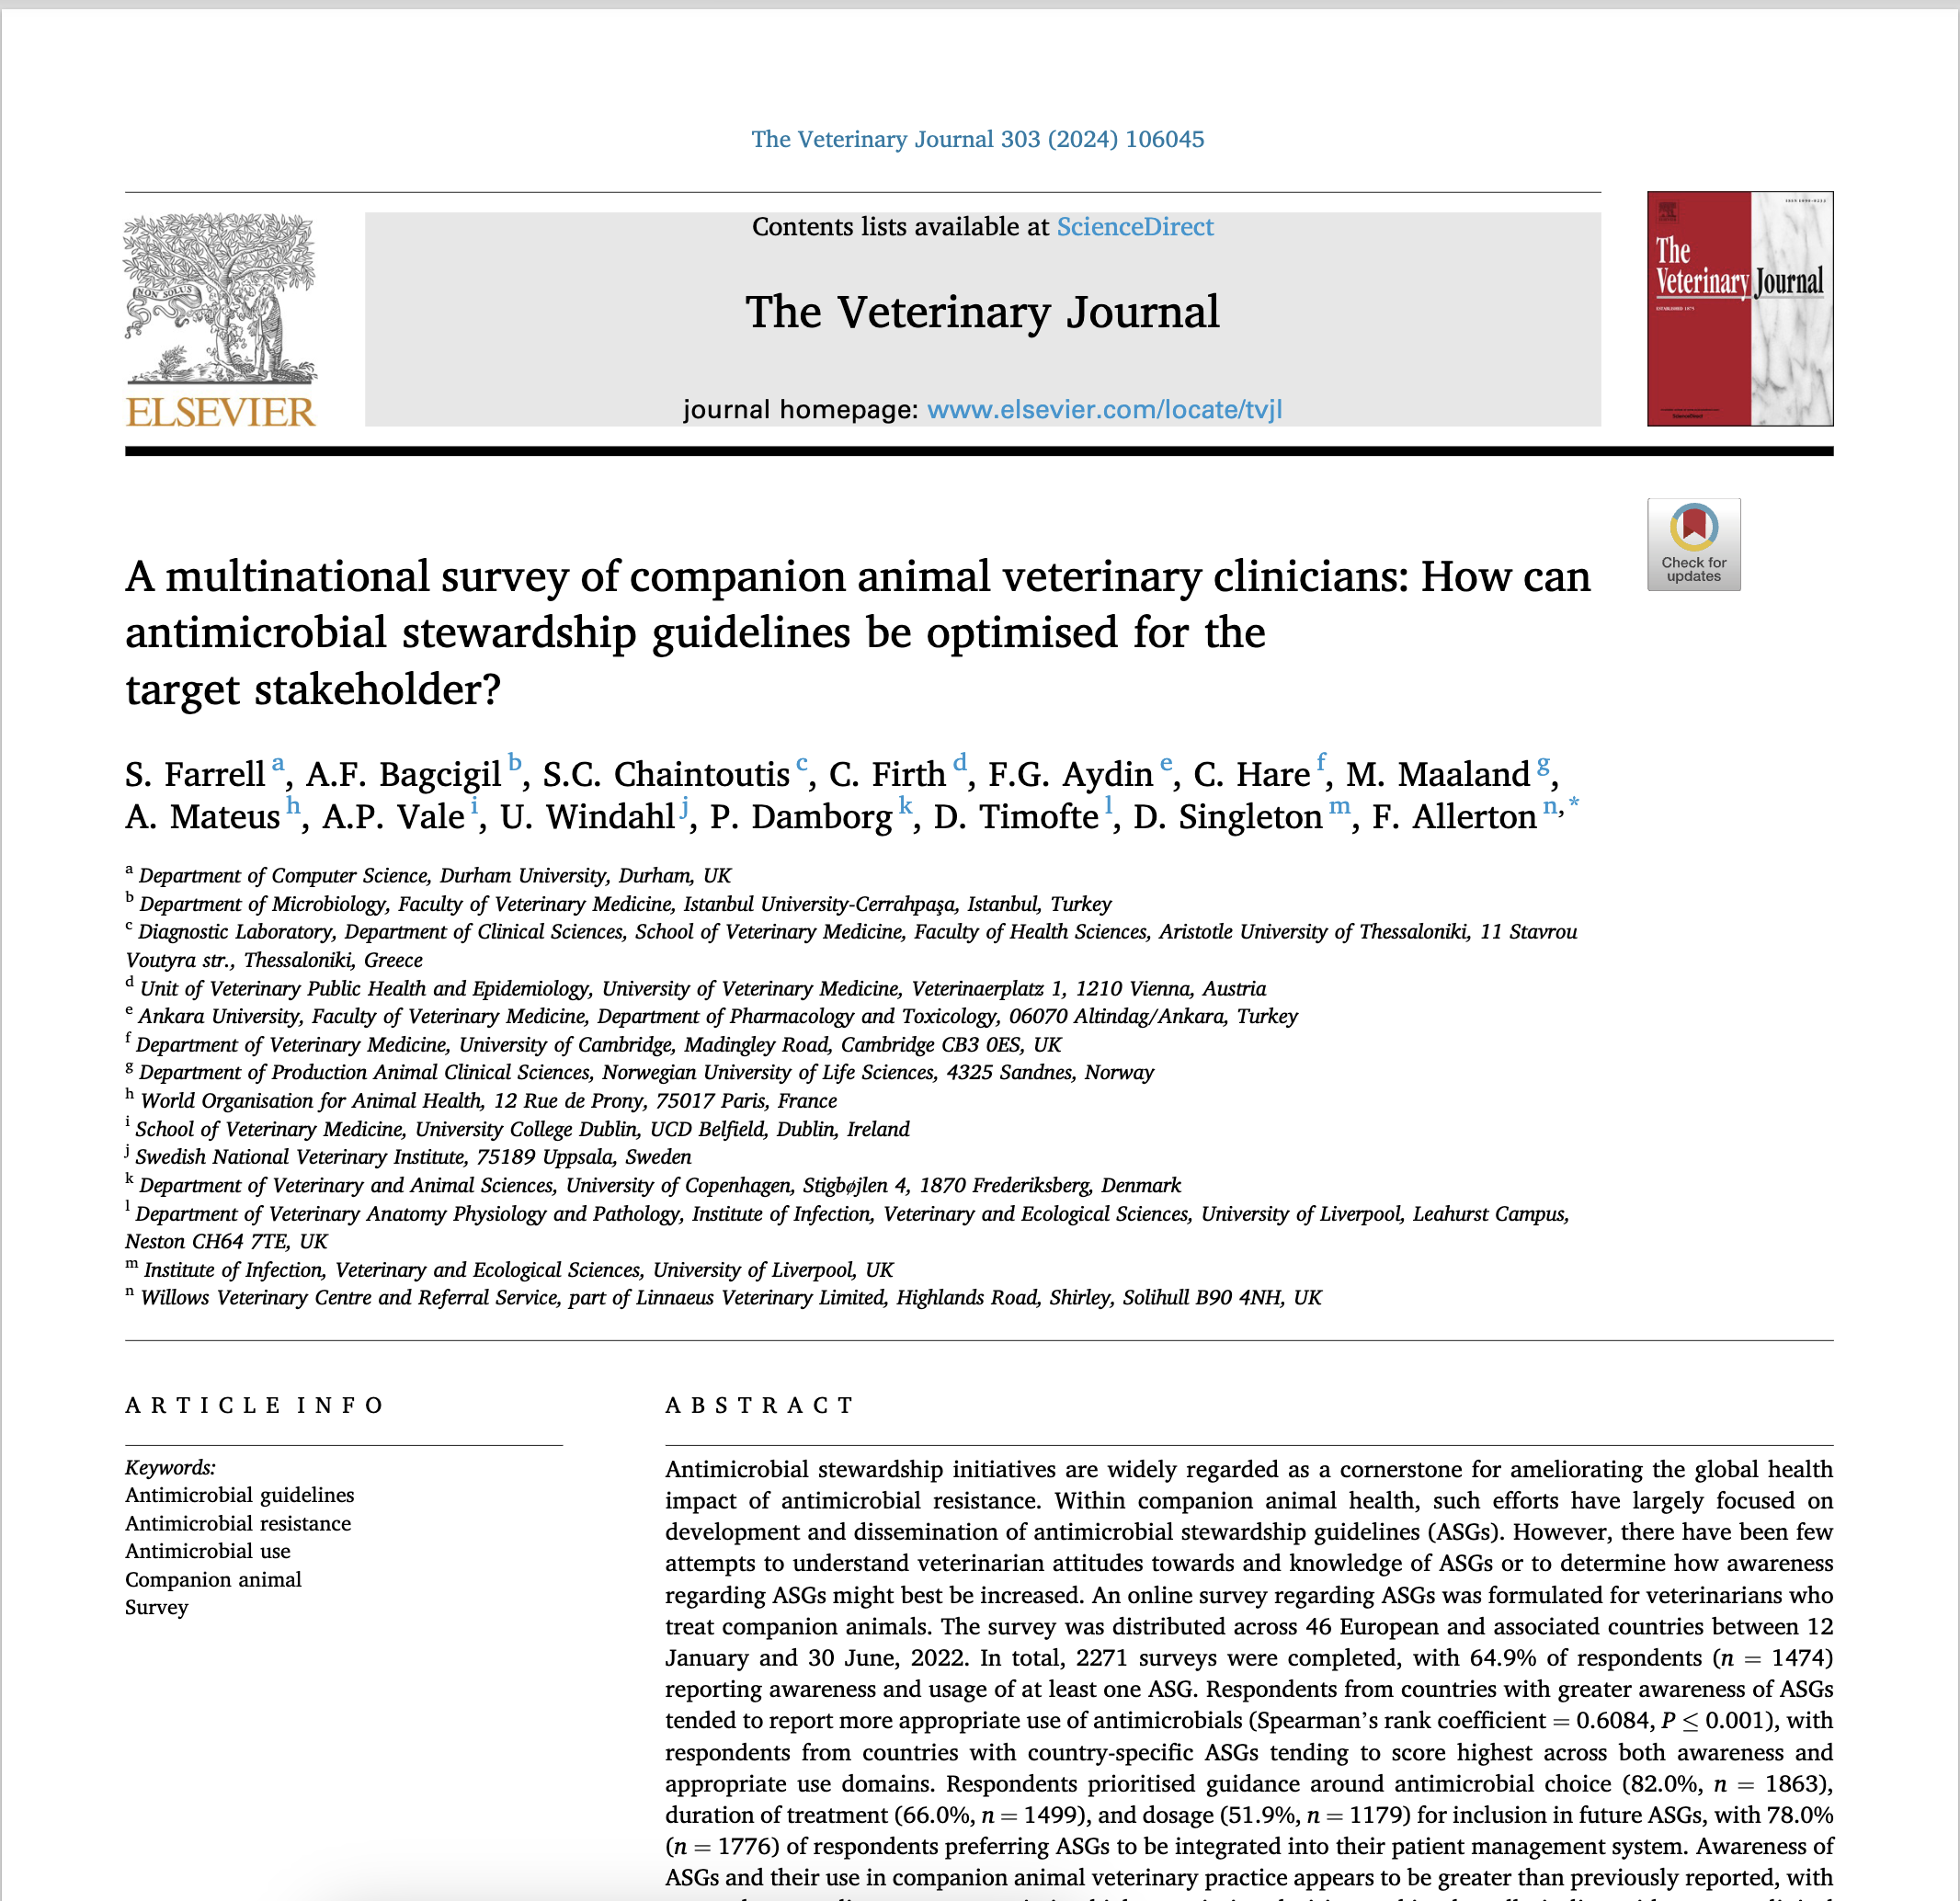
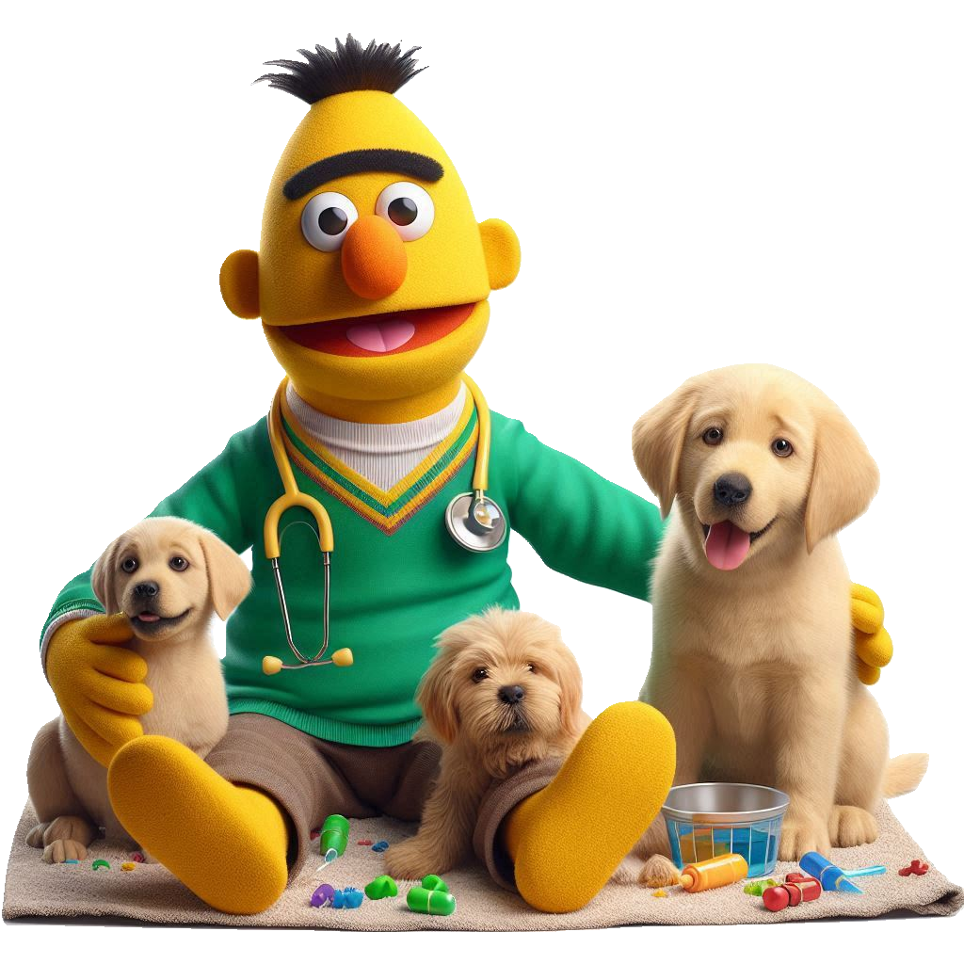
What do European vets claim to be using?
65% of vets surveyed reported awareness and use of at least one ASG.
In the UK 86% of vets surveyed reported awareness and use of at least one ASG

Slide 22
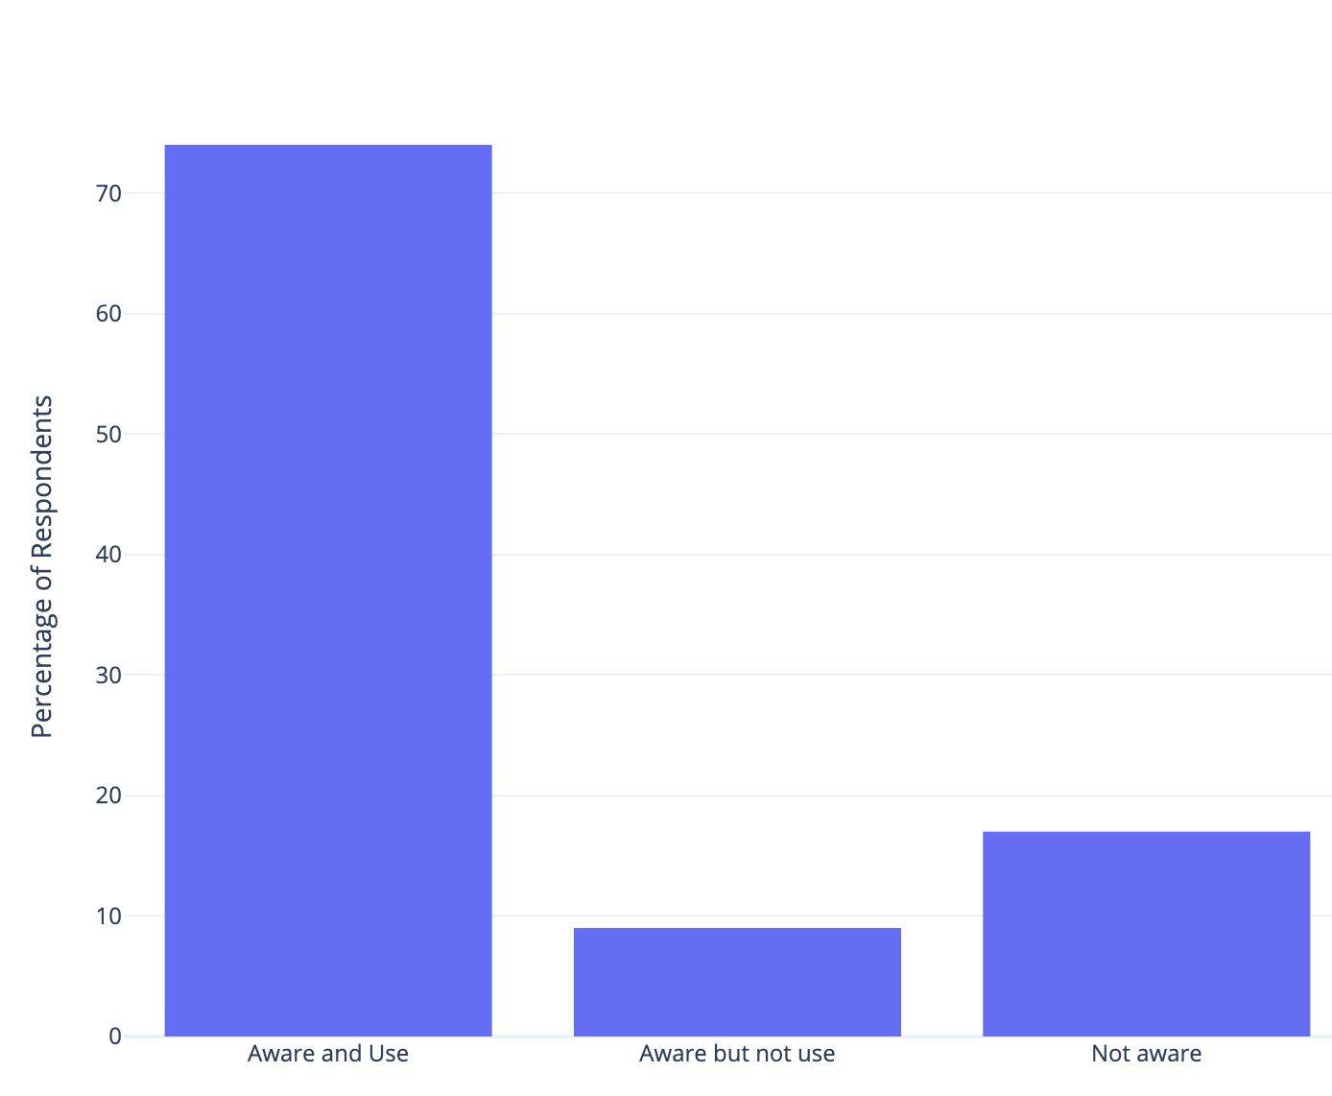
What do European vets claim to be using?
UK Clinicians' Response Rates on the Use of PROTECT ME
65% of vets surveyed reported awareness and use of at least one ASG.
In the UK 86% of vets surveyed reported awareness and use of at least one ASG
74%
74% of UK vets claim to be utilise PROTECT ME
9%
17%

Slide 23
Disease
PROTECT ME
Cat % Concordance
Dog % Concordance
Cat Bite Abscesses
Amoxicillin Clavulanate, Cefalexin
Fluroquinolones
89%
61%
Conjunctivitis
Chlortetracycline
Fusidic Acid
Gentamycin
42%
39%
Keratitis
Topical Gentamycin
Topical Ciprofloxacin
Topical Ofloxacin
4%
6%
First line
Second line

Slide 24
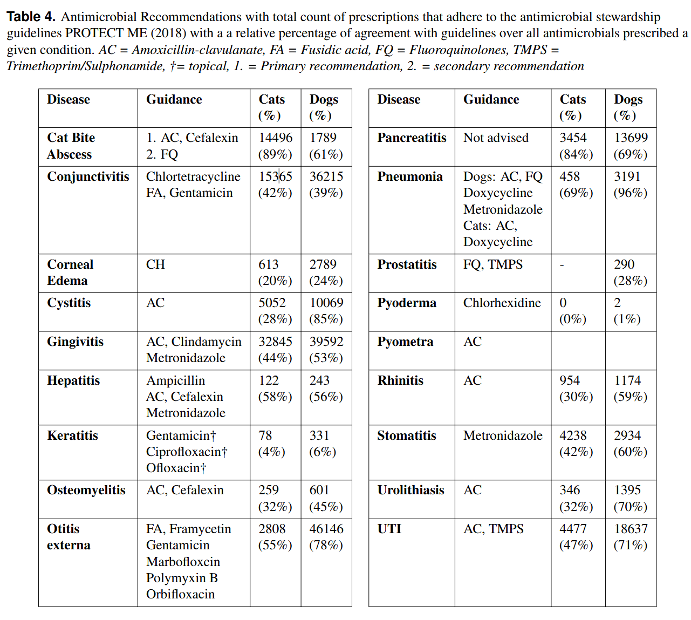

Limitations
‘Incorrect prescription’ on paper
≠
‘Incorrect Prescription’ in practice
No idea which vets use PROTECT ME
Diagnoses not written in notes cannot be considered
SAVSNET only partially represents the UK population
Some misclassifications inevitable
Antimicrobials not charged for not counted
Multiple diagnoses hard to parse
First line
Second line

Slide 25


Thank you to our 2024 sponsors!
Thanks!
Sean Farrell
sean.farrell2@durham.ac.uk
P-J Noble
rtnorle@Liverpool.ac.uk
Individual Donors:
Dr. Craig Carter
Dr. Jon Lustgarten

Slide 26





@avinformatics #Talbot24 #BetterDataSavesPets
Education & Recognition Programs
Volunteer Opportunities
Annual Talbot Symposium (earn RACE CE)
Al Hahn Lifetime Achievement Award
VetBloom Education Portal
Webinar Series
Committees
Education
Al Hahn Award
Outreach
Interoperability
Executive Board
Projects

